Slide 1


Batch Customization
10/20/2014
Presenters name, Title - Date

Slide 2
Core Job Customization
10/20/2014

Slide 3
Core Job Customization
Keyword File
Bulk Data Load Processes
Membership Maintenance
Provider Maintenance
Utilization Management
Claims
Accumulator

Slide 4
Keyword File
10/20/2014

Slide 5
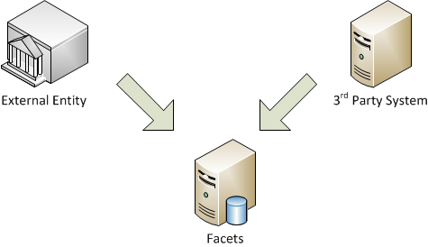
Keyword File
Some data may be maintained outside of Facets.
Enrollment
Provider Maintenance
Some data may need to be supplied by external entities.
3rd Party Claims
Medicare Enrollment/Disenrollment

Slide 6
Keyword File
PROBLEM!
The inbound data may not be same among the systems and entities.
Solution?
Facets needs a common file layout for bulk data load.
In Facets, it is called “Keyword” file
A keyword file is…
A comma delimited file used to load large volume of data in the Facets database.
A file converter needs to be written.

Slide 7
Keyword File
The keyword format is made up of three parts.
Key, which is typically “@” + “p” + Field Name
Literal (=)
Actual Value
e.g. @pLAST_NAME = “SMITH”
Each keyword is specialized for its own purpose.
Keyword for Membership Maintenance
Keyword for Claims
Keyword for Provider Maintenance
…

Slide 8
Keyword File
How would you answer?
Why Facets needs “keyword files” when EDI transaction sets are available?

Slide 9
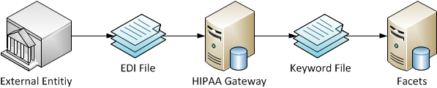
Keyword File
Electronic Data Interchange (EDI)
The electronic transmission of information between computers or trading partners.
The Accredited Standards Committee (ACS) X12 was chartered by the American National Standards Institute (ANSI) to develop uniform electronic data interchange standards.
Facets supports the EDI Transaction Sets with the help of TriZetto HIPAA Gateway.
The outputs from HIPAA Gateway is Keyword files.
The knowledge of Keyword can be useful when you need to trouble shoot the issues.

Slide 10
Membership Maintenance
10/20/2014

Slide 11
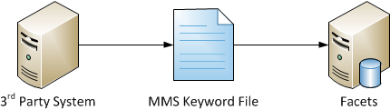
Membership Maintenance
MMS Keyword File
Comma delimited file that inserts new membership records or updates the existing membership records.
A file converter needs to be written.
Some clients utilize Facets Enrollment Toolkit (FET) to aid the creation of the MMS keyword files
A MMS Keyword file processed by ErCcsRunMms0.

Slide 12
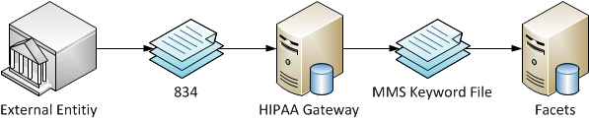
Membership Maintenance
“834” Transaction Set
Facets supports the 834 Transaction Set with the help of TriZetto HIPAA Gateway.
FaFhgRunBinb
Runs on HIPAA Gateway.
Parse an inbound 834 file, and generate a MMS keyword file.
ErCcsRunMms0
Runs on Facets Application Server.
Process the MMS keyword file.
Communicates with HIPAA Gateway.

Slide 13
Provider Maintenance
10/20/2014

Slide 14
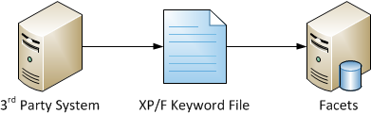
Provider Maintenance
XP/F Keyword File
Comma delimited file used to facilitate the initial loading and subsequent maintenance of providers and their associated information (addresses, network affiliations, credentialing, etc.).
A file converter needs to be written.
Note! There is no standard inbound data set or file layout.
A XP/F Keyword file processed by ErCcsRunXpf0.

Slide 15
Utilization Management
10/20/2014

Slide 16

Utilization Management
UMI Keyword File
Comma delimited file used to facilitate loading referrals and pre-authorizations to the Facets database.
A file converter needs to be written.
Note! There is no standard inbound data set or file layout.
TriZetto has build number of solutions to aid the creation of UMI keyword files.
e.g. UMI Solution Framework
A UMI Keyword file processed by ErCcsRunUmi0.

Slide 17
Claims
10/20/2014

Slide 18
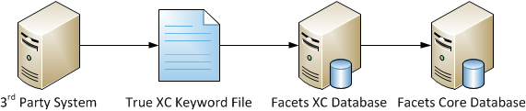
Claims
True XC Keyword File
Comma delimited file used to load external claims into Facets.
A file converter needs to be written.
A True XC Keyword file processed by ErCmcRunXc00.
Once successfully processed, the claims are stored in the Facets XC Database.
Electronic Claims Adjudication jobs need to be run to bring the claims to the Facets CORE database.

Slide 19
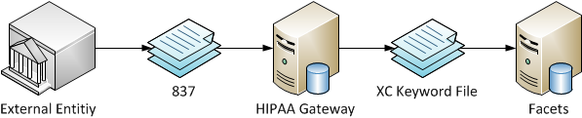
Claim
“837” Transaction Set
Facets supports the 837 Transaction Set with the help of TriZetto HIPAA Gateway.
FaFhgRunBinb
Runs on HIPAA Gateway.
Parse an inbound 837 file, and generate a XC keyword file.
ErCcsRun837i
Runs on Facets Application Server.
Process the XC keyword file.
Communicates with HIPAA Gateway.

Slide 20
Accumulator
10/20/2014

Slide 21
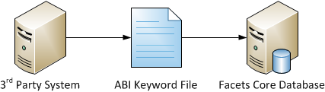
Accumulator
ABI Keyword File
Comma delimited file used to facilitate loading and subsequent updates to the Member Accumulator table and Family Accumulator table.
A file converter needs to be written.
Note! There is no standard inbound data set or file layout.
TriZetto has build number of solutions to aid the creation of ABI keyword files.
e.g. ABI Solution Framework
An ABI Keyword file processed by ErCcsRunAbi0.

Slide 22
Accumulator
Exporting Accumulator from Facets
The two important files produced by ErCcsRunAbe0
Member Accumulator Extract
Family Accumulator Extract
Why exporting accumulator?
Typically, a client has a vender which adjudicates certain claims for them.
The vender needs the accumulator data to adjudicate the claims correctly.
Once adjudicated, the vender sends the paid claims to the client.
The client add the claims in Facets and update accumulator via the ABI job.

Slide 23
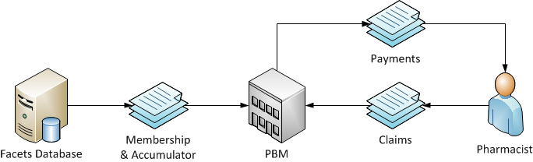
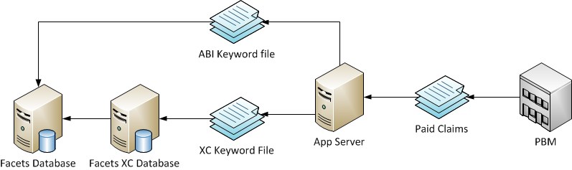
Accumulator
Example: Pharmacy Claims

Slide 24
Custom Jobs
10/20/2014

Slide 25
Custom Jobs
There are always needs for custom jobs!
File Conversions
Data Scrubs
Data Extracts
…
The features of Facets batch architecture cab be leveraged to create custom jobs.
Avoid the risky and costly creating of own solution from scratch.
Keep the consistent functionalities with Facets Core jobs.

Slide 26
Custom Jobs
Components for Custom Jobs
Procedure File
Runbook
Windows Scripting Language (VBScript)
Executable File
Stored Procedure(s)
Typical Approach for Building Custom Jobs
Implement a most business logic in a stored procedure.
Write an executable file to invoke the stored procedure.
A WSL (VBScript) will execute the executable file.
A procedure file will define a step to execute the WSL (VBScript), and parameters.
A runbook will have parameters that can be overridden.

Slide 27
Custom Jobs
Something to Think About…
Executable File
Must be a console application. No GUI is allowed.
Accept arguments in Main().
e.g. Database Source, Port Number, User ID, Password, etc.
Any messages should be written to Console.
WSL (VBScript)
Update Process() function to invoke the executable file.
Make sure to pass arguments to the executable file.
Check StdOut and StdErr to intercept the messages from the executable file.
If the executable file is successfully completed, return True. Otherwise, return False.

Slide 28
Trouble Shooting
10/20/2014

Slide 29
Trouble Shooting
Where do I look for errors?
Return Code of the Job
Event Log
Combined Batch Output
Individual Engine Output
.JCL File
Facets Capture Log
Script Tracing

Slide 30
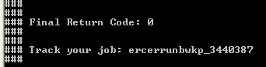
Trouble Shooting
Return Code
0 = Successful
8 = Unsuccessful
Final Return Code
Points to the instance specific directory

Slide 31
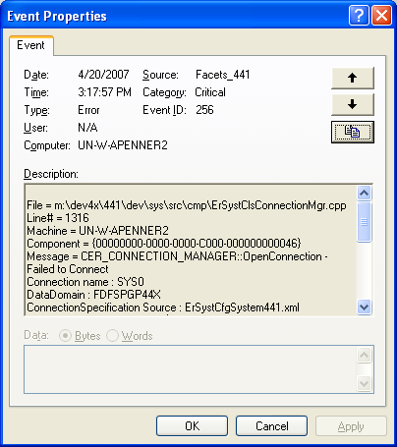
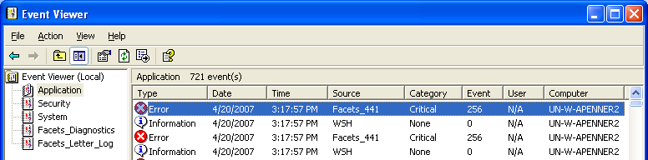
Trouble Shooting
Event Log
File and Line number of Facets code
Application Event Log
Facets Exception

Slide 32
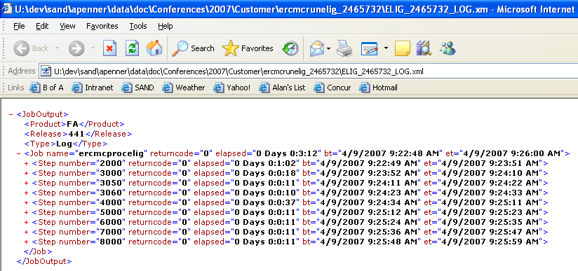
Trouble Shooting
Combined Batch Output
Output from every step, action and engine combined into one XML file

Slide 33
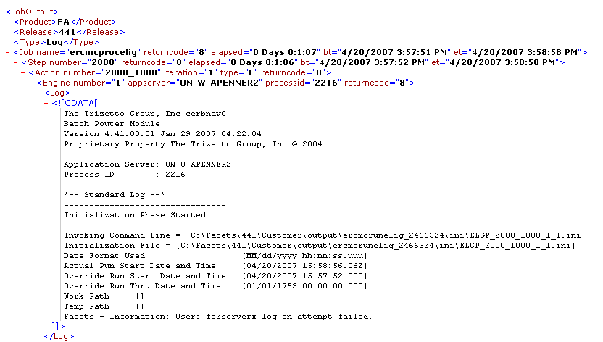
Trouble Shooting
Combined Batch Output
Return code at all levels
Application Server and Process
Error Text

Slide 34
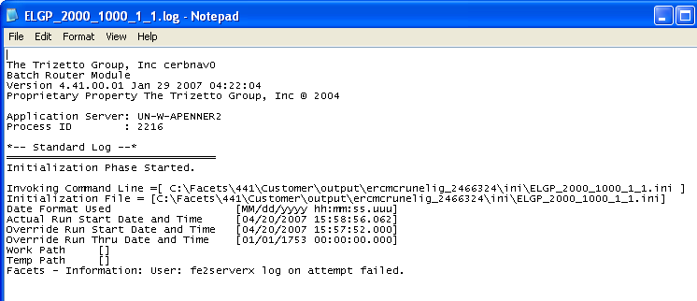
Trouble Shooting
Combined Batch Output
Individual engine output file
Error text

Slide 35
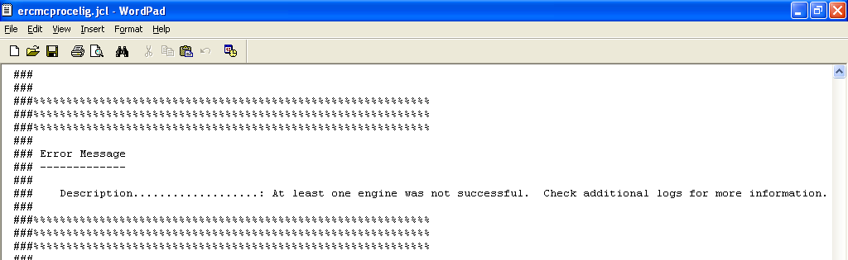
Trouble Shooting
.JCL File
Error text

Slide 36
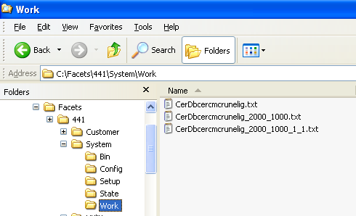
Trouble Shooting
Database Capture
Captures every client server request.
Optionally captures results of client server requests.
Set via override at any level.
Default location
Separate files for each job, step, action and engine

Slide 37
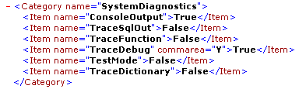
Trouble Shooting
Script Tracing
Provides information pertaining to application server framework.
Production Safe!
Preferred for production

Slide 38
Assignment
October 16, 2014

Slide 39
Assignment
You are asked write a custom job to generate claim summary from Facets. The requirements are as follows…
In the file, Claim ID, Group ID, Subscriber ID, Member Suffix, Member First Name, Member Last Name, Service Date, and Paid Date.
The claims must be paid in Year 1999.
The member suffix needs to 2 character long, and has leading 0 if necessary.
The output file is a comma separated file.
Challenges!
Create the output file in a fixed length file.
Create the output file in an “Excel spreadsheet”, but you can’t invoke Excel from you code.

Slide 40
Q & A
October 16, 2014

